Slide 1



Market Booms & Busts:
Canadian Housing Analysis
Presented by:
THE CHAMPS
March 27^{th,} 2020
Notes:
Presenter: Michael
SCRIPT : Hello all, I would like to introduce our team. We are the champs, and at my monitor to my left we have Eric, Rimsha and Andrew, and we are The Champs. We will be providing an hypothesis we developed and tested, and would like to share our analysis at the end.

Slide 2


Agenda
Final Statement
Hypothesis
Conclusion of Analysis
Goal
Analysis:
District Housing
Core Questions
Analysis:
Housing vs. Stock
Data
Collection/ Cleaning
Notes:
Presenter: Michael
Script: Going through bubbles, read through each
Our focus will be on finding API’s, with a historical dataset, ranging within time periods of Recessions (1990, 2000, 2008-2010).
We will be collecting information from API’s Stock markets and Real Estate Sales in Canada during the same time period and provide an analysis
In addition we will analyze the relationship between house value and geographic location.
Final Analysis- Housing opportunities?
Our analysis will be
-Collect Real Estate, Stock Price Analysis data during 2008-2010.
-Compare to Real Estate housing prices and Stock Prices within those time
periods, identifying trends.
-Finalize our analysis by identifying a correlation between during these times,
being able to identify when a recession could occur.
-Bonus- Collect Real Data from Kijiji and use our findings to identify buying
opportunities based on lower prices

Slide 3

Hypothesis:
Does Real Estate have a strong correlation with the Recession?
Notes:
Presenter: Michael
Script:
Question for the Class! Using Zoom, put up a blue hand if you believe our Hypothesis is true.
As many of you know, we have seen a drastic shift in many of our family or friend's lives as we brace for a challenging economic future. We decided to look into what many deem a reliable investment, real estate ,and ask the question. can we can identify if there is a positive Correlation with a Recession.
Using Recession, we can identify if there is a housing price drop.
The correlation between house prices and the stock market is positive.
Both Real Estate and Stock prices will decrease during a recession
Using this info, we will be able to predict house prices in upcoming recessions.
House value will decrease towards the downtown core
Null Hypothesis: Recession has no impact on housing prices
Alternative Hypothesis: Recession has impact on housing prices
How Positive Correlation Works
A perfectly positive correlation means that 100% of the time, the variables in question move together by the exact same percentage and direction. A positive correlation can be seen between the demand for a product and the product's associated price. In situations where the available supply stays the same, the price will rise if demand increases.

Slide 4



Goals/Objectives
Identify Recession Time Period
Housing Purchasing Opportunities
Stock Pricing Opportunities
Future Investment
Notes:
Presenter: Michael
Script: We will looking at key goals to test our hypothesis, and our first goal was to to establish historical time points for our data set, specifically recession periods.
We will then be collecting housing market prices within Canada.
Once we have our housing Data, we will be using an API to gather our Stock prices with overlapping Time Periods, and will be able to provide an analysis based on these conduct our discoveries.
Our Final goal will be to conduct see if we can use our findings to discover a potential investment opportunity.
Find API for Data Collection
-
Our focus will be on finding API’s, with a historical dataset, ranging within time periods of Recessions (1990, 2000, 2008-2010).
We will be collecting information from API’s Stock markets and Real Estate Sales in Canada during the same time period and provide an analysis
In addition we will analyze the relationship between house value and geographic location.
Findings on Housing Prices
Our analysis will be
-Collect Real Estate, Stock Price Analysis data during 2008-2010.
-Compare to Real Estate housing prices and Stock Prices within those time
periods, identifying trends.
-Finalize our analysis by identifying a correlation between during these times,
being able to identify when a recession could occur.
-Bonus- Collect Real Data from Kijiji and use our findings to identify buying
opportunities based on lower prices
Lng + Lat map/chart/table – showing where it is most profitable to purchase a home (Andrew’s findings basically)

Slide 5

Core Questions:
Housing
Do housing prices and recession have a positive correlation
Can we identify the most profitable district in the current housing market?
Investment Opportunity
When a recession happens, would it be more
profitable to invest in Stocks or Real Estate?
Notes:
Presenter: Michael
Script : So some key questions that we will be trying to answer.
So our key discovery will be, is there a positive correlation with housing prices and recessions?
Looking into potential investments, what would be the best investment; Stock Markets or Real Estate?
And finally, As we dug through many Datasets, we will also have a deeper analysis within Real estate in Toronto, and potential within our local districts.
How does Real Estate get affected by a recession?
How do Stocks get affected by a recession?
How do they coexist during a recession?
What type of relationship do these datasets have? Positive, Negative or No Correlation?
If there is a Positive Correlation, can we make a prediction based on Historical Data for an potential recession?
Can you make the process of finding investment property more efficient?
Is there a correlation between geographic location and value?
1989 -1991
1999 - 2004
2006 – 2011
Question 1: How does Real Estate Get affected by a recession?
Question 2 :Does Stock Market have an effect on housing?
- Stock Market has a positive Correlation in some scenarios, Periods 1 and 3. both show positive correlation, yet in Periods 2 there is a negative correlation with our dataset. We cannot assume that the stock market has a direct correlation with 3 examples having unique results showing otherwise.

Slide 6

Data Collection – Time Period
1989 -1991 – Early 90’s Recession
1999 – 2004 – Tech Bubble
2006 – 2011 – Great Recession
Notes:
Presenter: Michael
Script: Now that we have our Questions, it's time to look into the Data!
We looked into recent Recessions, and decided to collect Data for each of these Time Periods. We extended our data sets to account for the trend during the entering and exiting of a recession, so we can provide additional analysis during these time periods.
Some of you might remember the Early 90's Recession within 1989 to 1991, the 2000's Tech Bubble and the Great Receession that peaked around early 2008.
Intro into Data
Data Cleanup, Data Analytics
Explanation of the Periods of Data
1989 -1991
1999 - 2004
2006 – 2011

Slide 7



Data Exploration:
Real Estate Data
CREA Data
Point 2 Homes
Stock Market Data
Yahoo Finance Stock API
S&P 500, NASDAQ, Russell 2000
Notes:
Presenters: Michael
Script: For our data collection, we collected a range of datasets for our 2 topics. We looked into CREA , which is the Canadian Real Estate Association which a 30 year range of housing prices within Canada. We also had data scraping from the real estate site, Point 2 Homes.
For our second Dataset, we gathered our Stock prices using a Yahoo Finance API collection, and gathered from commonly known Stock Indexes to compile our analysis.
The reasons for selecting these Datasets, was where we selected these Data sets, that held data for each time period that was specfic to our find
* Describe the exploration and cleanup process: What's on the slides
* Discuss insights you had while exploring the data that you didn't anticipate: Didn't anticipate that,
* Discuss any problems that arose after exploring the data, and how you resolved them
* Present and discuss interesting figures developed during exploration, ideally with the help of Jupyter Notebook
Real Estate Data
Average Sale Price: Residential: Canada ( $CAD)
From Jan 88’ to Feb 20’
Using realtor information from "Point2Homes" in GTA to find best investment
Stock Market Data
1990,2008 & Dotcom – years of recession
Chose S&P500, NASDAQ, and Russell 2000 because it gives good representation of market

Slide 8

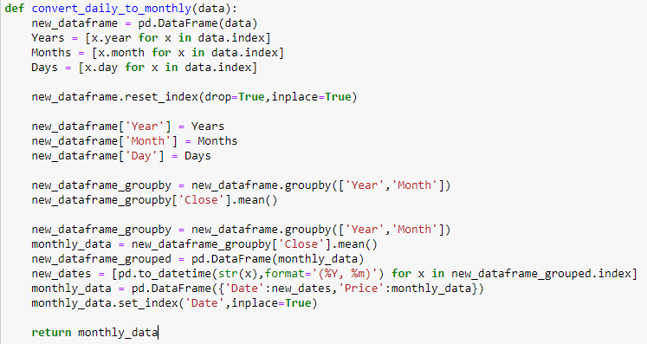
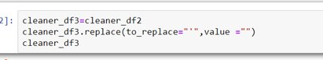
Data Cleanup
Real Estate Data
Stock Market Data
Excel sheet with extra rows of unrelated data
Cleanse Date Format.
Converted Daily stock data to monthly
Notes:
Presenter: MIchael, Eric
Michael Script : When first receiving the CREA data, we discovered data that we needed clean up the date column, which had a short form Date 3 Letters followed by an apostrophe. We had to create a naming convention to match our datasets, and ended up using Pandas Documentation to use .Replace to clean up our dates.
Eric Script: When plotting the housing data and stock data, there were issues because the housing data was presented as monthly data. The API would not allow a large amount of calls for monthly data, therefore the data needed be converted with python. This function seen below is what was used to convert the daily stock data into average monthly stock data
Data Cleanup & Exploration
* Describe the exploration and cleanup process: What's on the slides
* Discuss insights you had while exploring the data that you didn't anticipate: Didn't anticipate that,
* Discuss any problems that arose after exploring the data, and how you resolved them
* Present and discuss interesting figures developed during exploration, ideally with the help of Jupyter Notebook
Excel sheet with extra rows of unrelated data
Cleanse Date Format.- Could not read data without changing data format, data type
Stock Data Challenges-
Combined Data

Slide 9
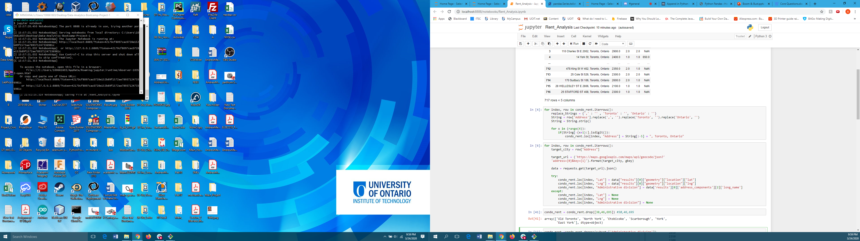
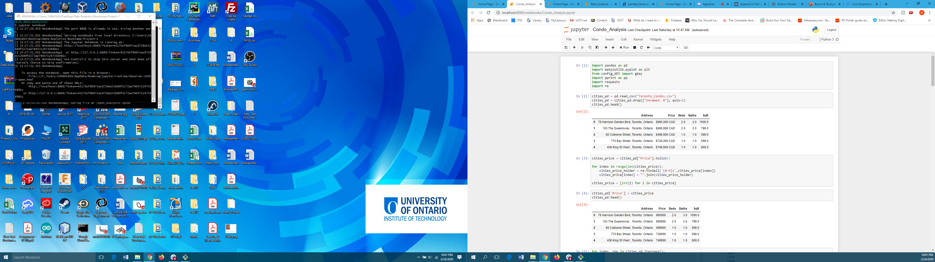
Data Cleanup
Housing District Data
Notes:
Presenter- Andrew
Data Cleanup & Exploration
* Describe the exploration and cleanup process:
* Discuss insights you had while exploring the data that you didn't anticipate:
* Discuss any problems that arose after exploring the data, and how you resolved them
* Present and discuss interesting figures developed during exploration, ideally with the help of Jupyter Notebook

Slide 10
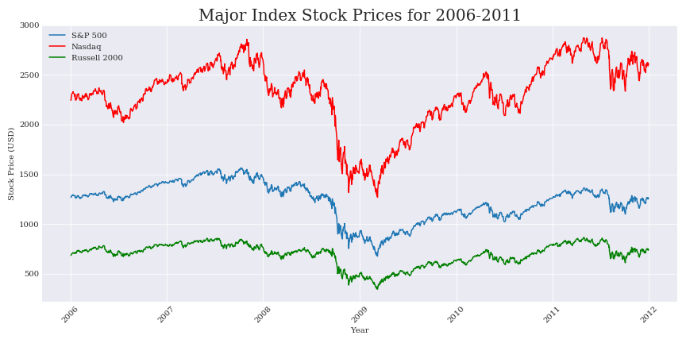
Data Consolidation:
Major Index Stock Prices for 2006-2011
Notes:
Presenter: Eric
Script: We collected data from 3 major indexes which were the S&P 500, Nasdaq and Russell 2000.
Each index was chosen for a specific reason.
The S&P 500 was chosen because it tracks the top 500 companies on the new york stock exchange
The Nasdaq tracks a more broader spread of the market
And the Russell 2000 tracks small-cap stocks
As Michael mentioned this data shows the index values before and after the recession

Slide 11
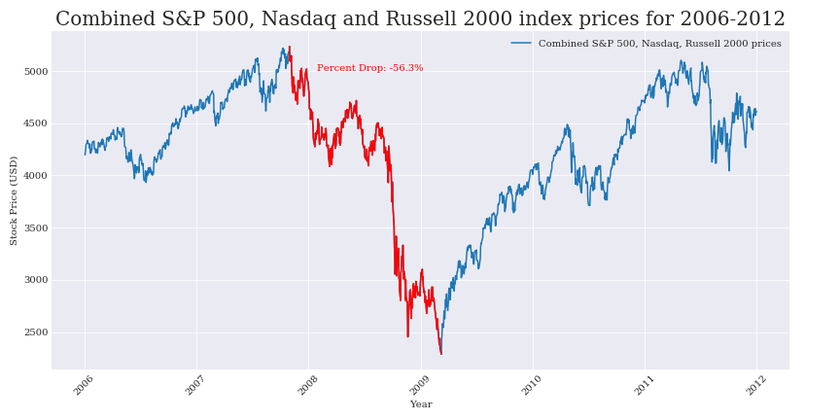
Data Consolidation:
Combined S&P 500, Nasdaq and Russell 2000
Notes:
Presenter: Eric
Script: We compiled the stocks prices retrieved from the S&P 500, Nasdaq, and Russell 2000 into one to get a better representation of the market.
The red plot shows the dip that occurred during this recession period.

Slide 12
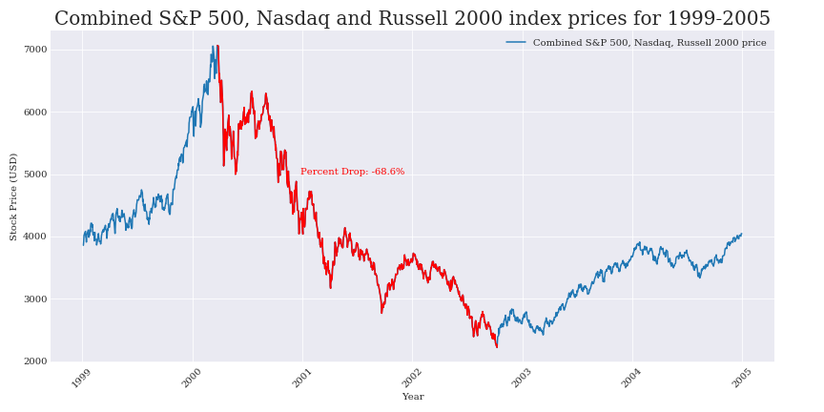
Data Consolidation:
Combined S&P 500, Nasdaq and Russell 2000
Notes:
Presenter: Eric
This plot is for 1999-2005 and also represents the combined index prices. This period had the largest drop.

Slide 13
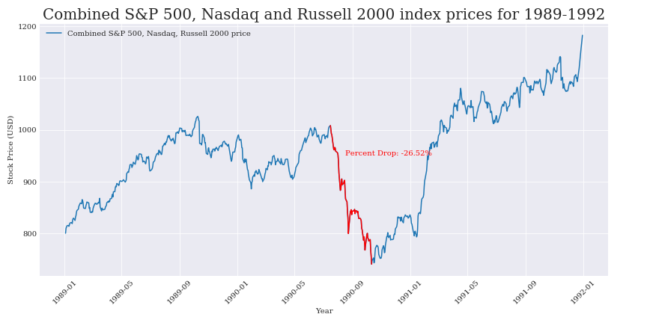
Data Consolidation:
Combined S&P 500, Nasdaq and Russell 2000
Notes:
Presenter: Eric
This is another similar plot for the 1989-1992 period. This period had the smallest drop.

Slide 14
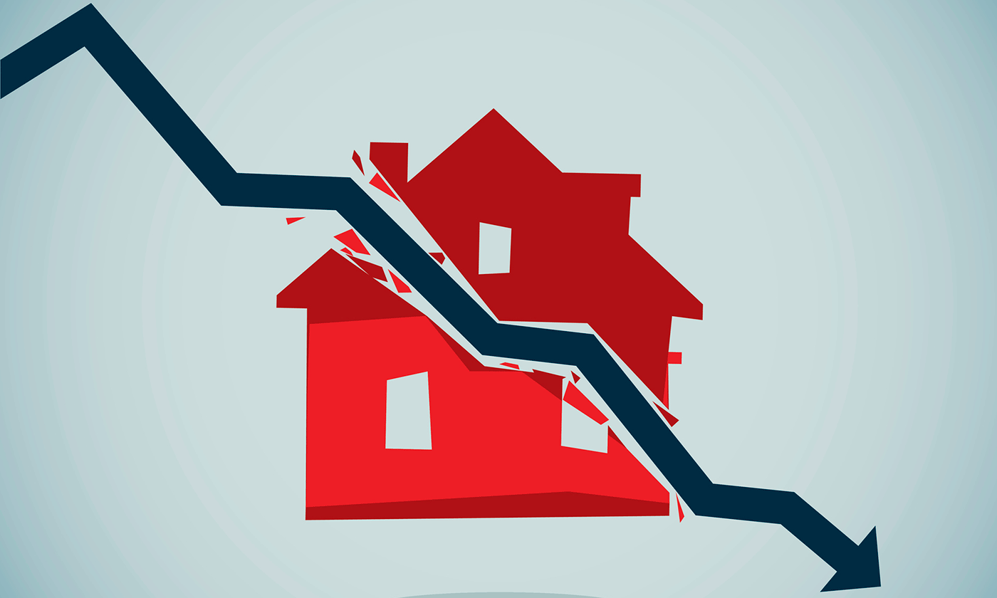
Question 1
Do housing prices and recession have a positive correlation?
Notes:
show the average monthly stock price (USD) and average house price (CAD) for the 3 periods of time we are focusing on for this analysis. Overall, the 3 graphs conclude that there is no positive correlation between housing and recessions. There is actually no correlation at all. Thus, these findings, don't support our hypothesis as originally thought. Now I'll go into depth analyzing these graphs.

Slide 15
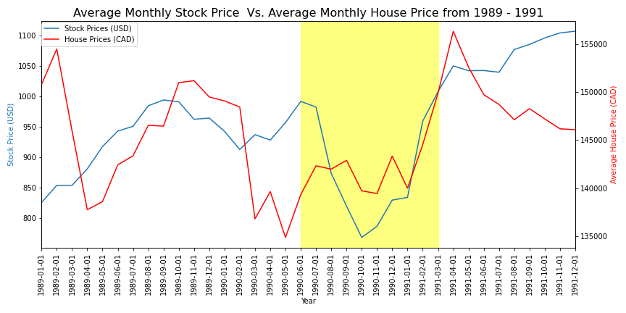
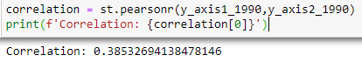
Data Analysis:
Housing Prices vs. Stock Prices Charts
Notes:
Highlighted part
Correlation: 0.3 = weak correlation

Slide 16
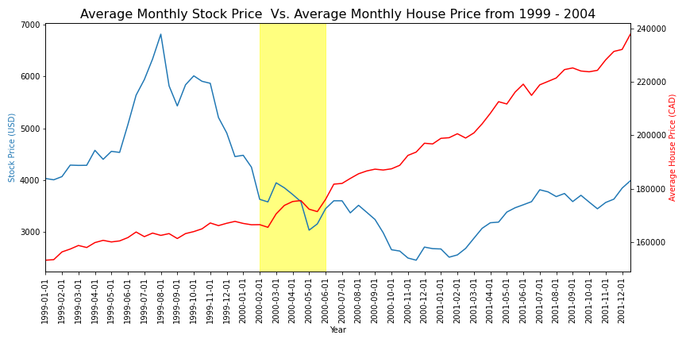
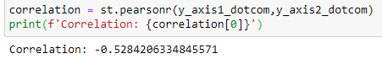
Data Analysis:
Housing Prices vs. Stock Prices Charts
Notes:
Shows negative correlation - This reason could explain the strong negative correlation.
Tech bubble = Between 1995 and March 2000, the NASDAQ rose 400% only to fall 78% . At this time Investors chose to invest in real estate as it’s a deemed safer to invest in than stocks. Resulted in major housing bubble

Slide 17
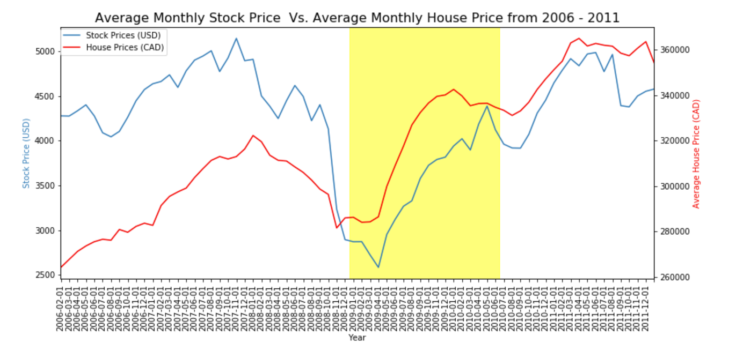
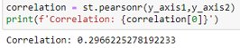
Data Analysis:
Housing Prices vs. Stock Prices Charts
Notes:
correlation is 0.29, we should take account for what happened during this time period. We can say there was a relationship between the stock market and real estate during these years. Essentially, the stock market crashed in 2008 due to the housing market.
Overall, you can see by these 3 graphs that there is no correlation between real estate and the recession. Logistically, this makes reasonable sense
Because during a healthy, growing economy, there’s increased spending in almost every product category. In other words, this is a general relationship – not something that’s specific between stocks and real estate. This isn’t to say, however, the real estate market never directly impacts the stock market, or vice versa . This is seen in isolated instances throughout the decades as shown in this last graph.
We’ve seen plenty of isolated instances in which it does.
But why did mortgage lenders make so many high-risk loans, especially without mortgage insurance? Because they were making money on those loans by selling them to a secondary market. Seeing that easy money in the rising real estate market, more and more stock market investors wanted to get in on the housing boom thinking they were buying into an appreciating asset but were actually buying up bad debt. As a result, When the housing market took a downturn and home prices began to dip in 2007,

Slide 18

Question 2
When a recession happens, is it more profitable to invest in stocks or housing?
Notes:
Presenter: Eric
Script:
Question 2 : When a recession happens, is it more profitable to invest in stocks or housing? Turn this to the class

Slide 19
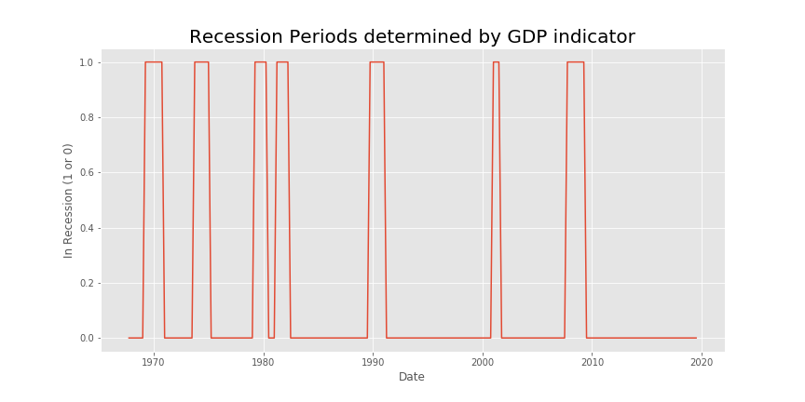
Data Analysis:
Calculating recession lengths
Recession indicated by two quarters of negative GDP growth
Notes:
Presenter: Eric
Script: To answer this question we first used the GDP indicator to identify periods of recession. This indicator shows a value of 1 if the time period is in recession, and 0 if it's not. This data was also used to calculate the average length of a recession, which was determined to be 14 months and also the start dates of each recession period.

Slide 20
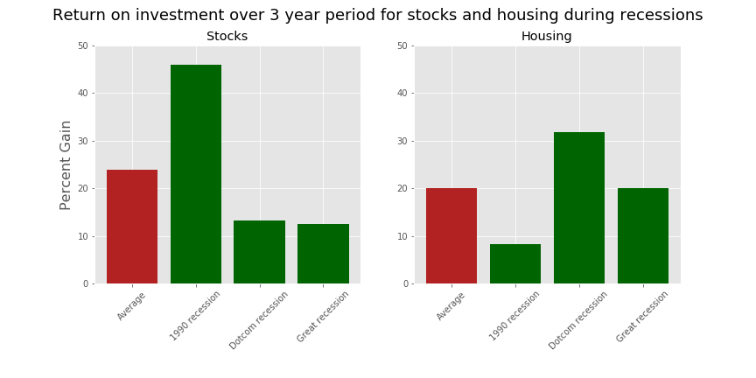
Data Analysis:
Investing in Stocks vs Housing during a recession
Notes:
Presenter: Eric
Script: From the GDP indicator we determined the average length of a recession to be 14 months. Using this information we came up with an investment strategy of
investing 10 months after the recession start date and keeping this investment in the market for a period of 3 years. This strategy was applied to both the stock and housing market to determine the best return on investment.
In green the chart shows the percent gains in the stock and housing markets for each recession period. In red the chart shows the average percent gain for the stock and housing markets.
The chart shows that on average there is a higher return on investment from the stock market during a recession. Although the 1990 recession has a large impact on the average stock return and definitely increases the average percent gain from stocks, you have to take into account the fact that housing returns are impacted by other factors which diminish the value of housing investments such as realtor fees (sometimes 10%), mortgage interest fees, and tax on capital gains. This investment strategy also does not take into account DCA strategy.
Therefore our analysis shows it is more profitable to invest in stocks rather than housing during a recession.

Slide 21

Question 3
Can we identify the most profitable district in the current housing market?

Slide 22
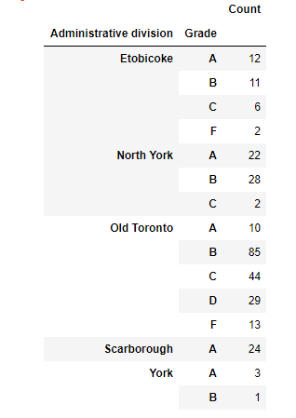
Data Analysis:
Andrew's Findings

Slide 23

Conclusions
Recessions and Housing Prices do not have a positive correlation.
During a recession, it is more profitable to invest stocks than real estate
Scarborough was more profitable for GTA district.
Notes:
Presenter: Michael
Script: No positive correlation between housing and recessions. Can be explained by real estate being deemed a safer investment during recession periods
More profitable to invest in stocks than housing. Lots of costs associated with housing (rent, taxes etc.)
Scarborough has more . Daniel

Slide 24

Post Mortem
Difficulties:
Additional Questions:
Initially finding data was difficult
Paid APIs – mostly US or not historical data
Other indicators to see influence on housing market
Impact of demographics on purchasing opportunities
Notes:
Presenter- everyone
Michael – Real Estate has competitive analysis for data
- Canadian Data can be limited compared to US data
- Hypothesis was to broad, needed to be narrowed down.
Eric – Are there other indicators which would help in determining the housing market trends pre-emptively?
- How does age demographics or income demographics influence if real estate or stocks are more profitable?

Slide 25

Thank You!

